Slide 1
Welcome to today’s Webcast
Today’s event will start at
10:00 a.m. ET/ 7:00 a.m. PT/ 4:00 p.m. CET
Please note that your lines are muted upon entry
You will not be able to communicate by audio
Please use the Q&A window
The presentation will begin at 3 minutes past the hour

Slide 2
Building a Successful Social Media Program
Alexandra Krasne
Senior Manager, New Media
Global Partner Marketing

Slide 3

Agenda
Listen
Define Your Audience
Engage
Measure
Next steps

Slide 4



Questions to Ask Before You Begin
Which executives will champion the efforts?
Are there SMEs to help create content and perhaps participate?
What is the workflow management strategy to handle responses and engagement?
Do team members have a social media skill set or will efforts be outsourced?
How much time and resources are available to put towards social media efforts?
1
1
1

Slide 5
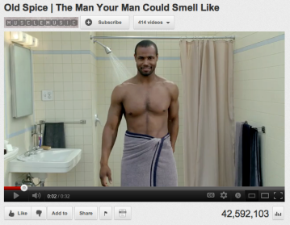
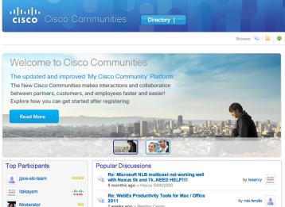
Success Stories
Old Spice “man your man could smell like” 23 million average views per video
Cisco deflects 120,000 support cases per month thanks to the support communities
Honda campaign increased Facebook fans from 15,000 to 422,000 and generated 3500 dealer quotes

Slide 6

What are Your Goals?
What types of metrics or results do you want to achieve?
What is the call to action?
Think about how the social media goals map to the company’s overall goals.
Are the social media goals realistic for the audience and team bandwidth?

Slide 7
Listen First

Slide 8

Creating a Listening Plan
STEP ONE:
Identify the audience
Who are they?
Segmentation?
Do they use social media and where?
Listen to key conversations

Slide 9

Creating a Listening Plan
STEP TWO
Join the social streams
Select keywords to focus “listening”
Identify topics, competitors, customers, or industry peers to “listen” to
Understand conversations around brands, solutions, and customer support
No hard selling, become a trusted expert

Slide 10

Creating a Listening Plan
STEP THREE
Research how peers are using social media channels
Observe their communication style and how the audience reacts
Take note of different ways they are using social media
Follow industry pundits to find trends

Slide 11

Creating a Listening Plan
STEP FOUR
Create an internal response plan
Work with SMEs on appropriate content
Route to other team members to resolve situations
Use results to inform content (blogs, videos, etc.)

Slide 12
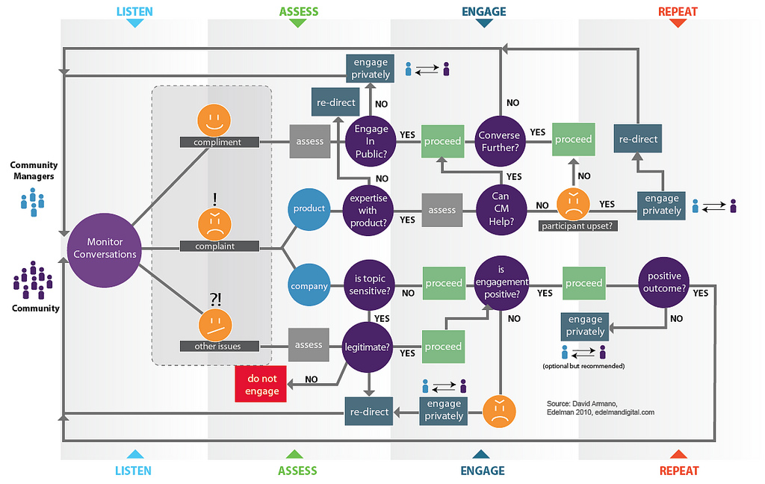
Creating a Listening Plan: Response Workflow
Image source: David Armano

Slide 13
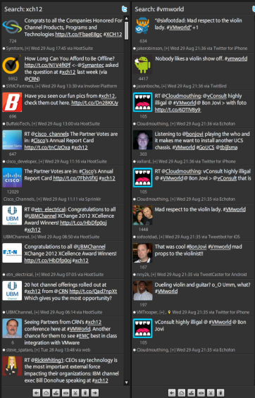
Free Listening Tool
TweetDeck
Search for relevant #hash tags
Create multiple columns with topics of interest
See what questions people are asking

Slide 14
Define Your Audience

Slide 15

Who is Your Audience?
Who is the target?
What are their titles and roles?
What industries are they from?
What regions will be involved?
Does the audience include decision makers, influencers, or other types?
Where does this audience spend time online and what do they do?
Define 3-4 audience segments
Think about ways to build relationships
CIO
Wants cloud solutions
Uses Twitter
Canada

Slide 16
Engage!

Slide 17

3 Steps to Engaging in Social Media
STEP ONE: Identify existing social media accounts to leverage
Avoid creating new accounts that may only be active for the duration of the program
Do you have enough content to seed a channel or does it make sense to use one central account?
Start slowly, build in more channels over time

Slide 18

3 Steps to Engaging in Social Media
STEP TWO: Outline communication activities and flow
Create 2-way dialogue opportunities through social media
Incorporate different styles and activities to engage audiences through social media
Be relevant and transparent to audience
Nurture social media feeds regularly

Slide 19

3 Steps to Engaging in Social Media
STEP THREE: Involve team members and executives
Empower team members and executives to participate in social media
Outline guidelines and main messaging to help get them started in the process

Slide 20
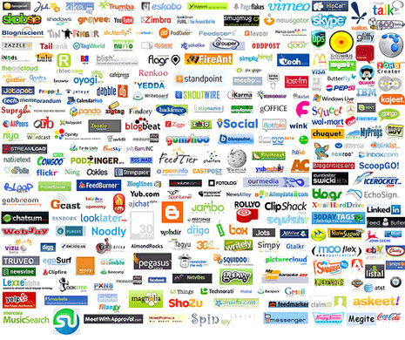
Content and Activities
What content will be used?
What is the messaging for the program?
What types of content already exist and can be used or converted?
Is there additional content that’s needed? If so, are there SMEs that can help curate content?
How can the content be positioned and used in different social channels?

Slide 21
Leverage Content Through Channels
Identify which communication channels will be used
Use social media to augment other communication channel efforts
Drive social media efforts back to centralized hub when there is a specific call-to-action
Create a mix of social media messages based on the main program messaging, content call-to-actions, 2-way dialogues, and awareness, mapping back to content
Include social sharing links in all communication efforts

Slide 22
Tying Content to Social Media Channels
Activity Example | Channel Example | Tactic Examples
Each activity type can be used in a variety of social channels Interactions (crowdsourcing) Education (information-sharing) Amplify (announcements, events, news, launches) | Twitter | Crowdsourcing 2-way direct dialogues Short call-to-action using keywords
 | Facebook | Polling Slightly longer call-to-actions Behind the scenes information Events Photos/videos
 | YouTube | Product overviews or ‘how-to’s’ Short messaging clips Thought leadership videos
 | LinkedIn | Group discussions around a topic Information-sharing and educational, not marketing
 | Blog | Feedback platform Thought leadership, expertise Series of educational posts Complicated concepts in “layman’s terms”

Slide 23
Centralized Hub Integration Map
Centralized Online Hub
(content links or posts)
White papers
Videos
Resources
Messaging
Call-to-actions
Online Hosting Areas (content posted in different channels, with a call-to-action pointing to the centralized hub; in some cases, these areas will already be displayed on the centralized online hub)
Blogs
YouTube
SlideShare
Online communities
Web pages
Communication Vehicles (each vehicle links to other channels, while the call-to-action points to the centralized online hub)
Email
Newsletters
Web advertising
Twitter
Facebook
LinkedIn

Slide 24
Metrics and Measurement

Slide 25

Monitor and Track
Determine what to monitor
Outline keywords and #hashtags to keep track of during the program
Use trackable links to measure how many clicks your post got
Focus on audience interactions and responses coming from different channels
See how call-to-actions are performing through social channels
What is the sentiment and how it is received?

Slide 26

Monitor and Track
Confirm metrics
Going back to the program objectives, what statistics and feedback are important?
What was the sentiment of the audience around the topic?
Are there benchmarks from similar efforts or is it brand new?
How did the social media efforts reach? Was it global?
Did influencers or more avid participants emerge from these efforts?
Was there more “media buzz” based on these efforts?

Slide 27
Key Takeaways and Next Steps
Key Takeaways
Identify which communication channels will be used
Drive social media efforts back to centralized hub
Create a mix of content based on the main program messaging, content call-to-actions, two-way dialogues, and awareness, mapping back to content
Include social sharing links in all communication efforts
Next Steps
Register for our next two webcasts: cisco.com/go/velocity (Social Media for Events, Creating an Integrated program)
WIN! Attend all 3 sessions and you’re entered into a drawing for marketing consultation offer worth $2500US
Follow Us
@Cisco_Channels and @PartnerVelocity
Download the Social Media eBook: slideshare.net/CiscoChannels

Slide 28
Further Your Knowledge
Go/Velocity Resources
Using Twitter to Network and Promote Your Business
Using Blogging and SEO to Grow Your Business
Go/PartnerMarketing Resources
Social Media Content Portal
Promotional Media Program
Video Testimonial Series
For All Resource Content Please Visit:
Cisco.com/Go/Velocity
Cisco.com/Go/Partnermarketing
For any issues accessing above hyperlinks please contact us.
Notes:
Visit cisco.com/go/velocity or go/partnermarketing to access these resources just for Cisco partners.

Slide 30
声明：
所有的版权属于原有公司，文件均来自公开渠道
此文件仅供学习使用，任何人不得进行以此为商业目的的行为
如有疑问，请立即删除
学习世界五百强和咨询公司PPT课程请访问如下网站搜索：“司马懿”
百度传课：司马懿PPT学校
网易学堂：司马懿PPT学校
知乎： 司马懿PPT学校
访问地址
https://www.chuanke.com
访问地址
https://study.163.com
访问地址
https://www.zhiu.com

